Slide 1

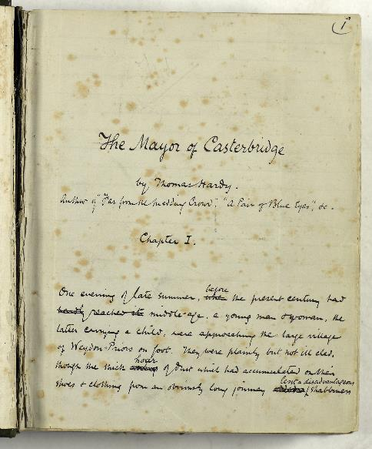
The Hardy Archive Project - fundraising and the first five months
Sam Johnston, County Archivist
Dr Ruth Burton, Project Archivist
Notes:
What’s in the archive? Well it consists of over 150 boxes containing thousands of individual items; correspondence, poetry, diaries, manuscripts, architectural plans, photographs, printed books and pamphlets, ephemera.
Much really valuable work was done on the archive by Andrew, Helen and others whilst it was at Dorset Museum but this is not visible to a public audience.
The collection is regularly added to e.g. the Stevens-Cox material (2020) and most recently the Hardy-composed drawings of Athelhampton Church (1861). It will continue to grow in the future as we proactively acquire further items, ideally through gift or deposit, but where necessary by purchase.
We have recently benefited from a National Manuscript Conservation Trust grant of £14,800 (Nov 2021). This has allowed us to work on some of the most fragile and significant items from the collection, some of which are on display across the four Dorset and Wiltshire museums currently exhibiting Hardy-themed exhibitions.

Slide 2
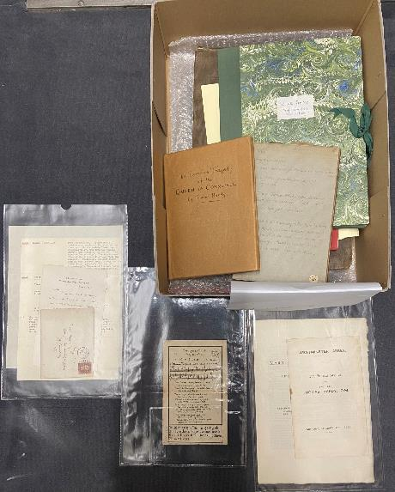
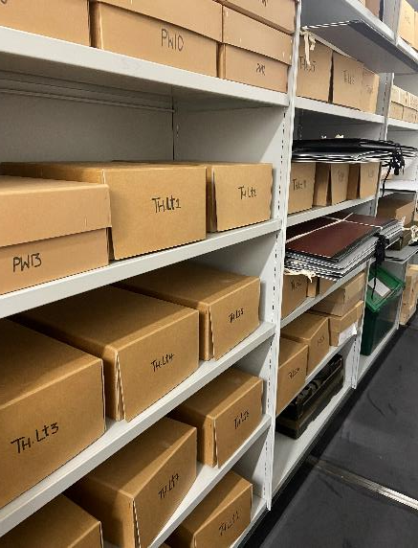
Unlocking Thomas Hardy – an access challenge
Background – provenance
Rationale – what is cataloguing?
Value as an enabler – education, digitisation, exhibition, research and cultural heritage
Notes:
What’s in the archive? Well it consists of over 150 boxes containing thousands of individual items; correspondence, poetry, diaries, manuscripts, architectural plans, photographs, printed books and pamphlets, ephemera.
Much really valuable work was done on the archive by Andrew, Helen and others whilst it was at Dorset Museum but this is not visible to a public audience.
The collection is regularly added to e.g. the Stevens-Cox material (2020) and most recently the Hardy-composed drawings of Athelhampton Church (1861). It will continue to grow in the future as we proactively acquire further items, ideally through gift or deposit, but where necessary by purchase.
We have recently benefited from a National Manuscript Conservation Trust grant of £14,800 (Nov 2021). This has allowed us to work on some of the most fragile and significant items from the collection, some of which are on display across the four Dorset and Wiltshire museums currently exhibiting Hardy-themed exhibitions.

Slide 3
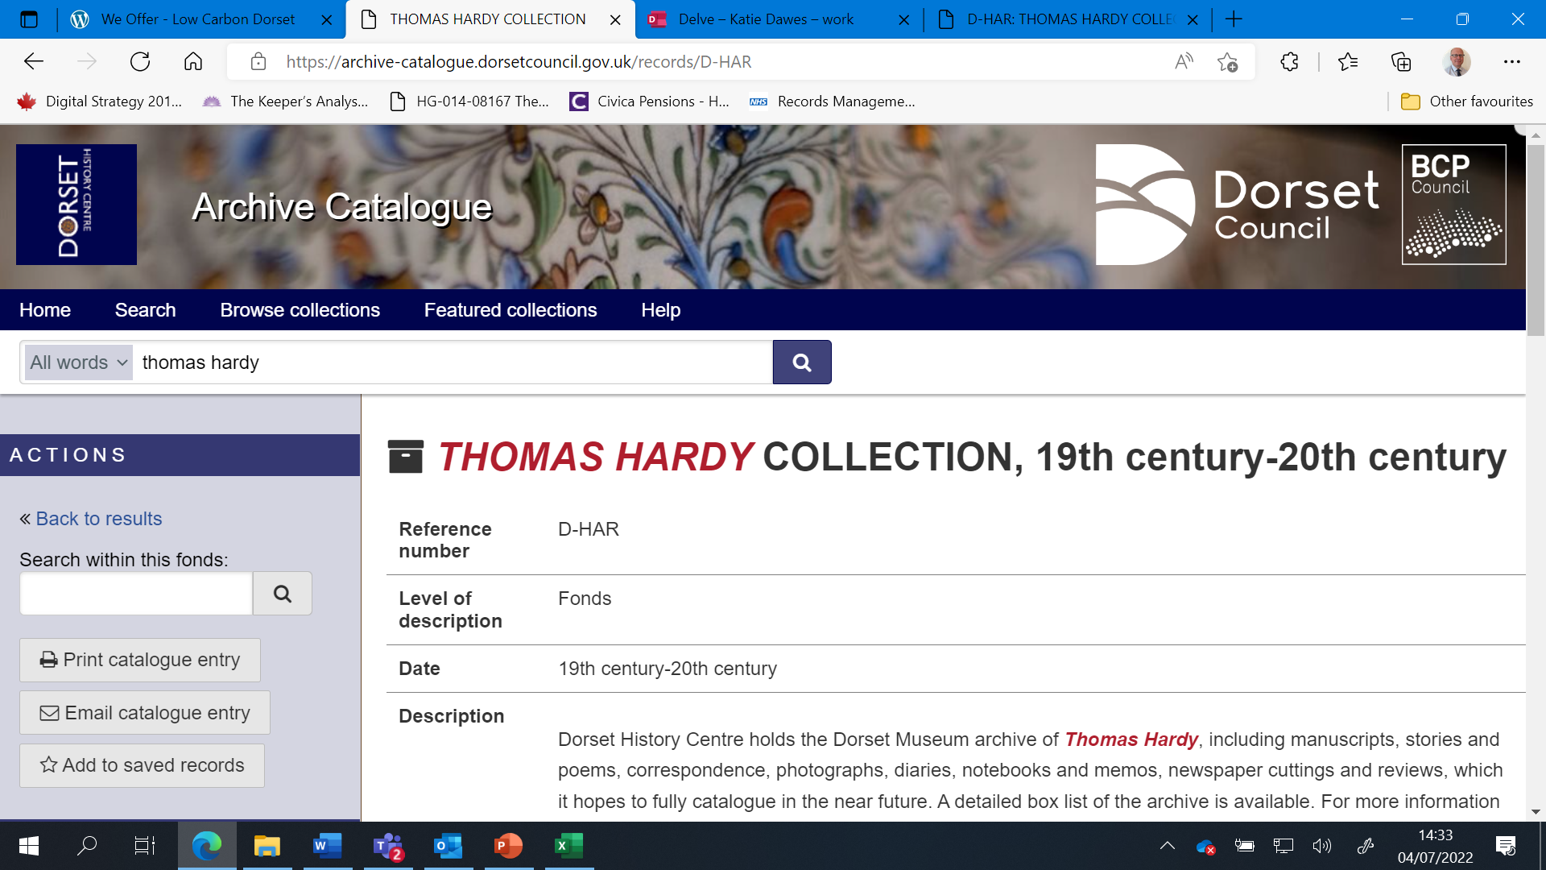
Notes:
Here is the collection level description you find if you look for Hardy on the DHC catalogue.

Slide 4
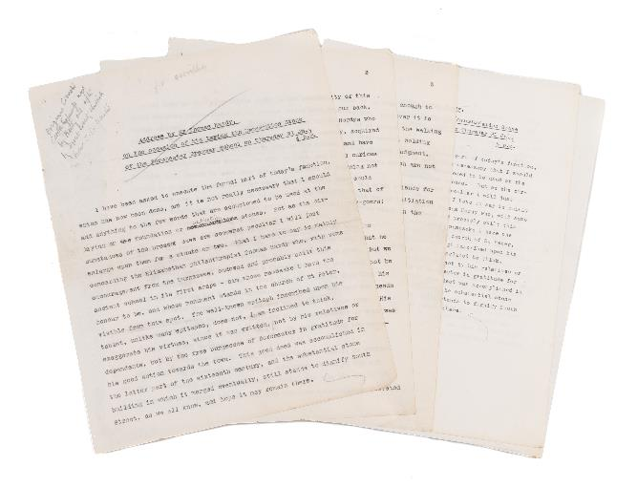
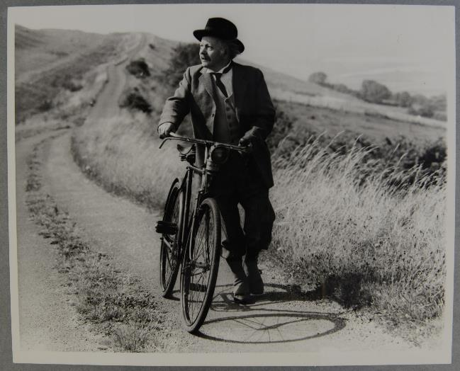
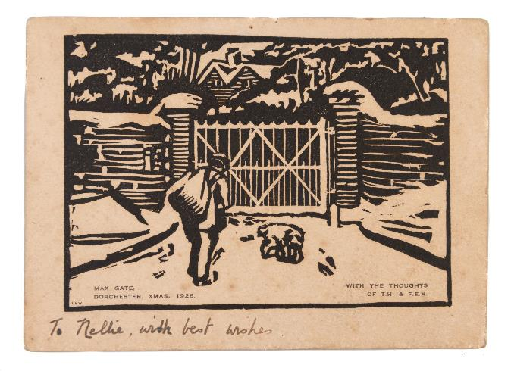
Challenges of fundraising
Not necessarily understood
Seen as of secondary importance to public engagement activity e.g. exhibition
Public generally prefer to fund ‘things’ not ‘posts’.
Very few funding bodies will support it.
Importance of Dorset Archives Trust
Notes:
So what are we hoping to do?:
We will create a detailed catalogue with item level entries for most of the contents of the archive - a resource that will be permanently discoverable online and a treasure trove of Hardy source material for scholars and the public alike. It will grow over time if more material is added to it.
Cataloguing works!: Similar scenario with the archives of Elisabeth Frink and the Bankes Family of Kingson Lacy whereby there was a growth in interest, access and research –
Partnerships: Dorset Archives Trust, museums, National Trust, University of Exeter, New Hardy Players

Slide 5
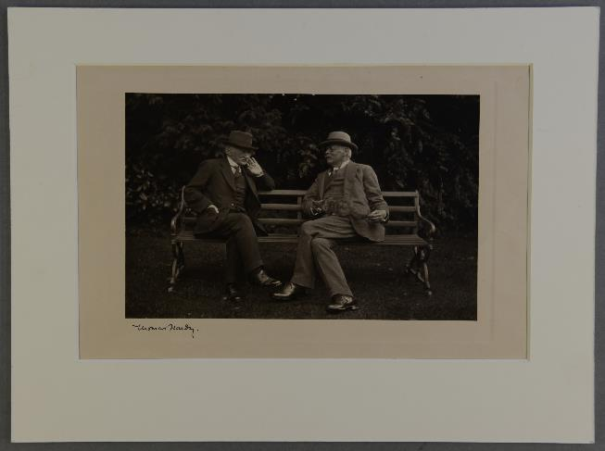
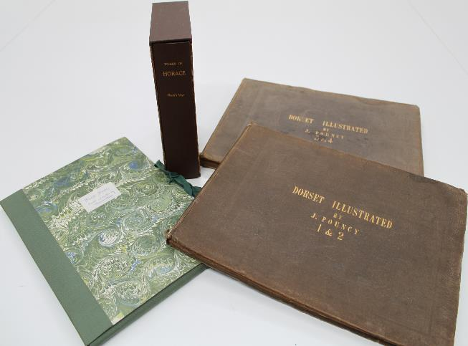
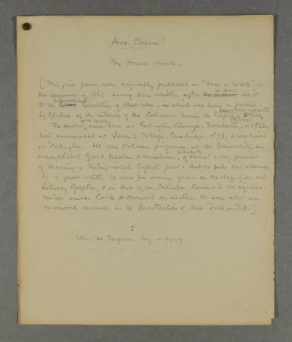
Growing the collection
Regular new acquisitions of Hardy material
All forms part of the wider Thomas Hardy archive
Over £70,000 spent since 2020 inc. Stevens Cox material (£50k)
Notes:
In order to create the catalogue, we will need to employ a suitably qualified and experienced archivist. Most of the funding we require is to support professional oversight of the catalogue’s creation and structuring.
We will also seek to recruit volunteers to support the archivist and ideally to lend any expert knowledge they may have to the process.
We have maintained for a long time a close engagement with Exeter University – particularly Professor Angelique Richardson and the Digital Humanities Department there
We may also carry out selective digitisation of parts of the archive - subject to resources and likely demand.
This project – should we raise sufficient funding forms an overall part of DHC’s emphasis on making collections accessible through cataloguing and public engagement. In the fullness of time it is something we’d like to do with the other literary archives at DHC.

Slide 6
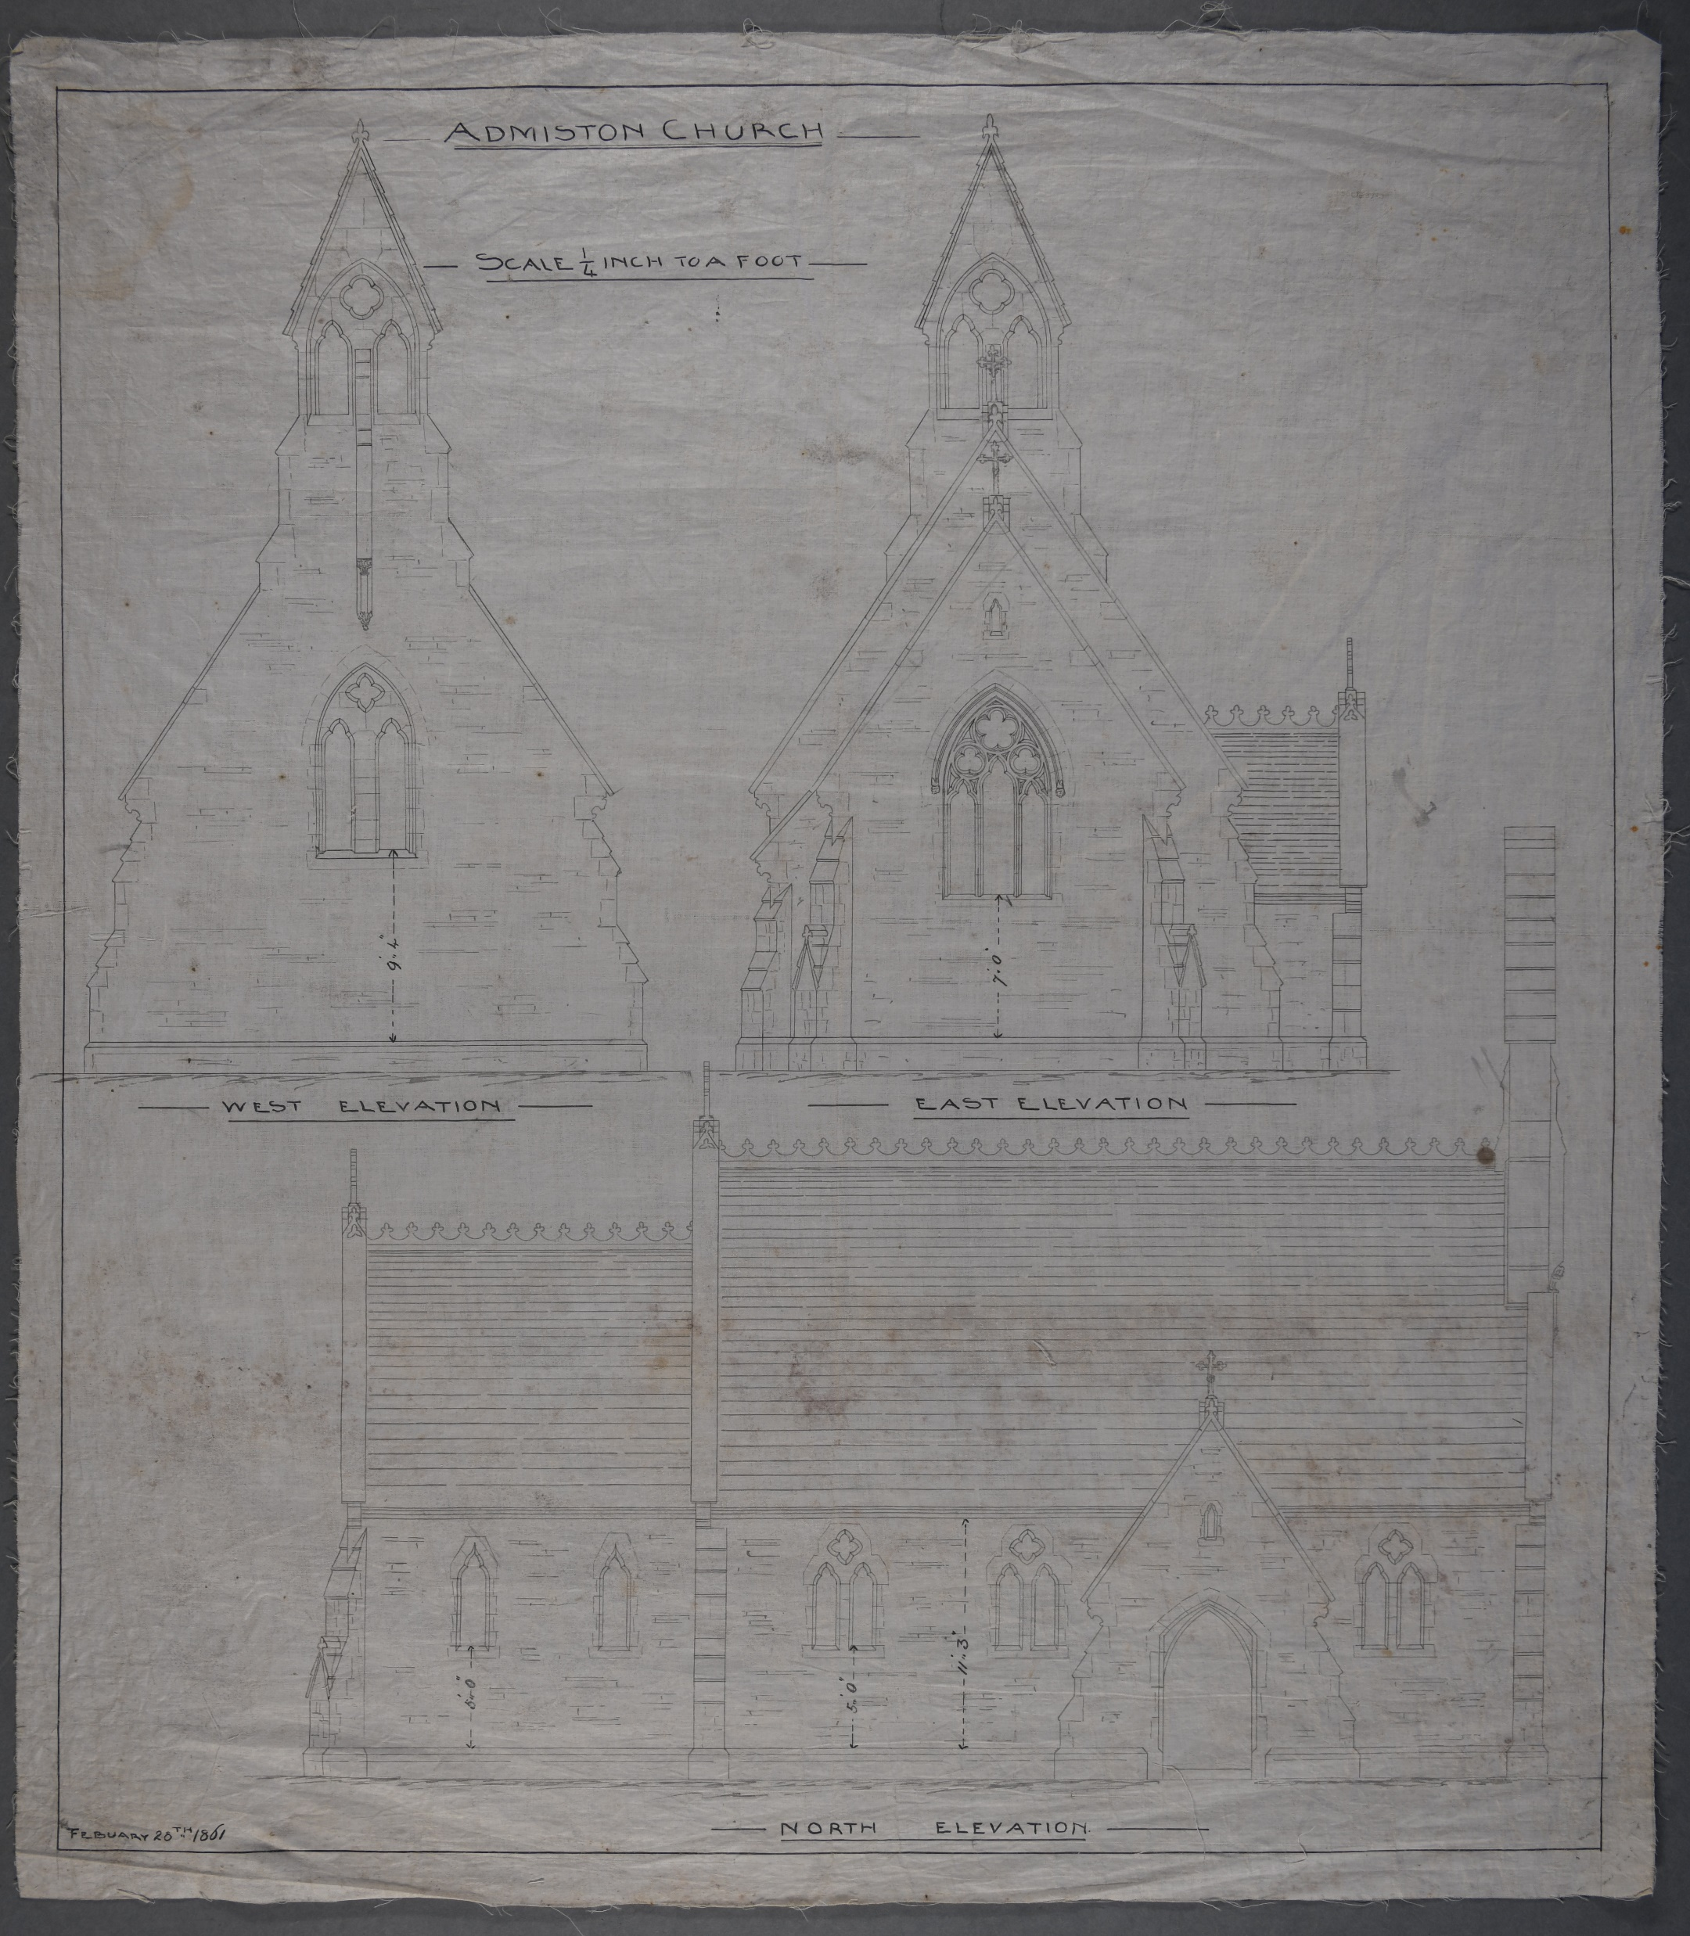
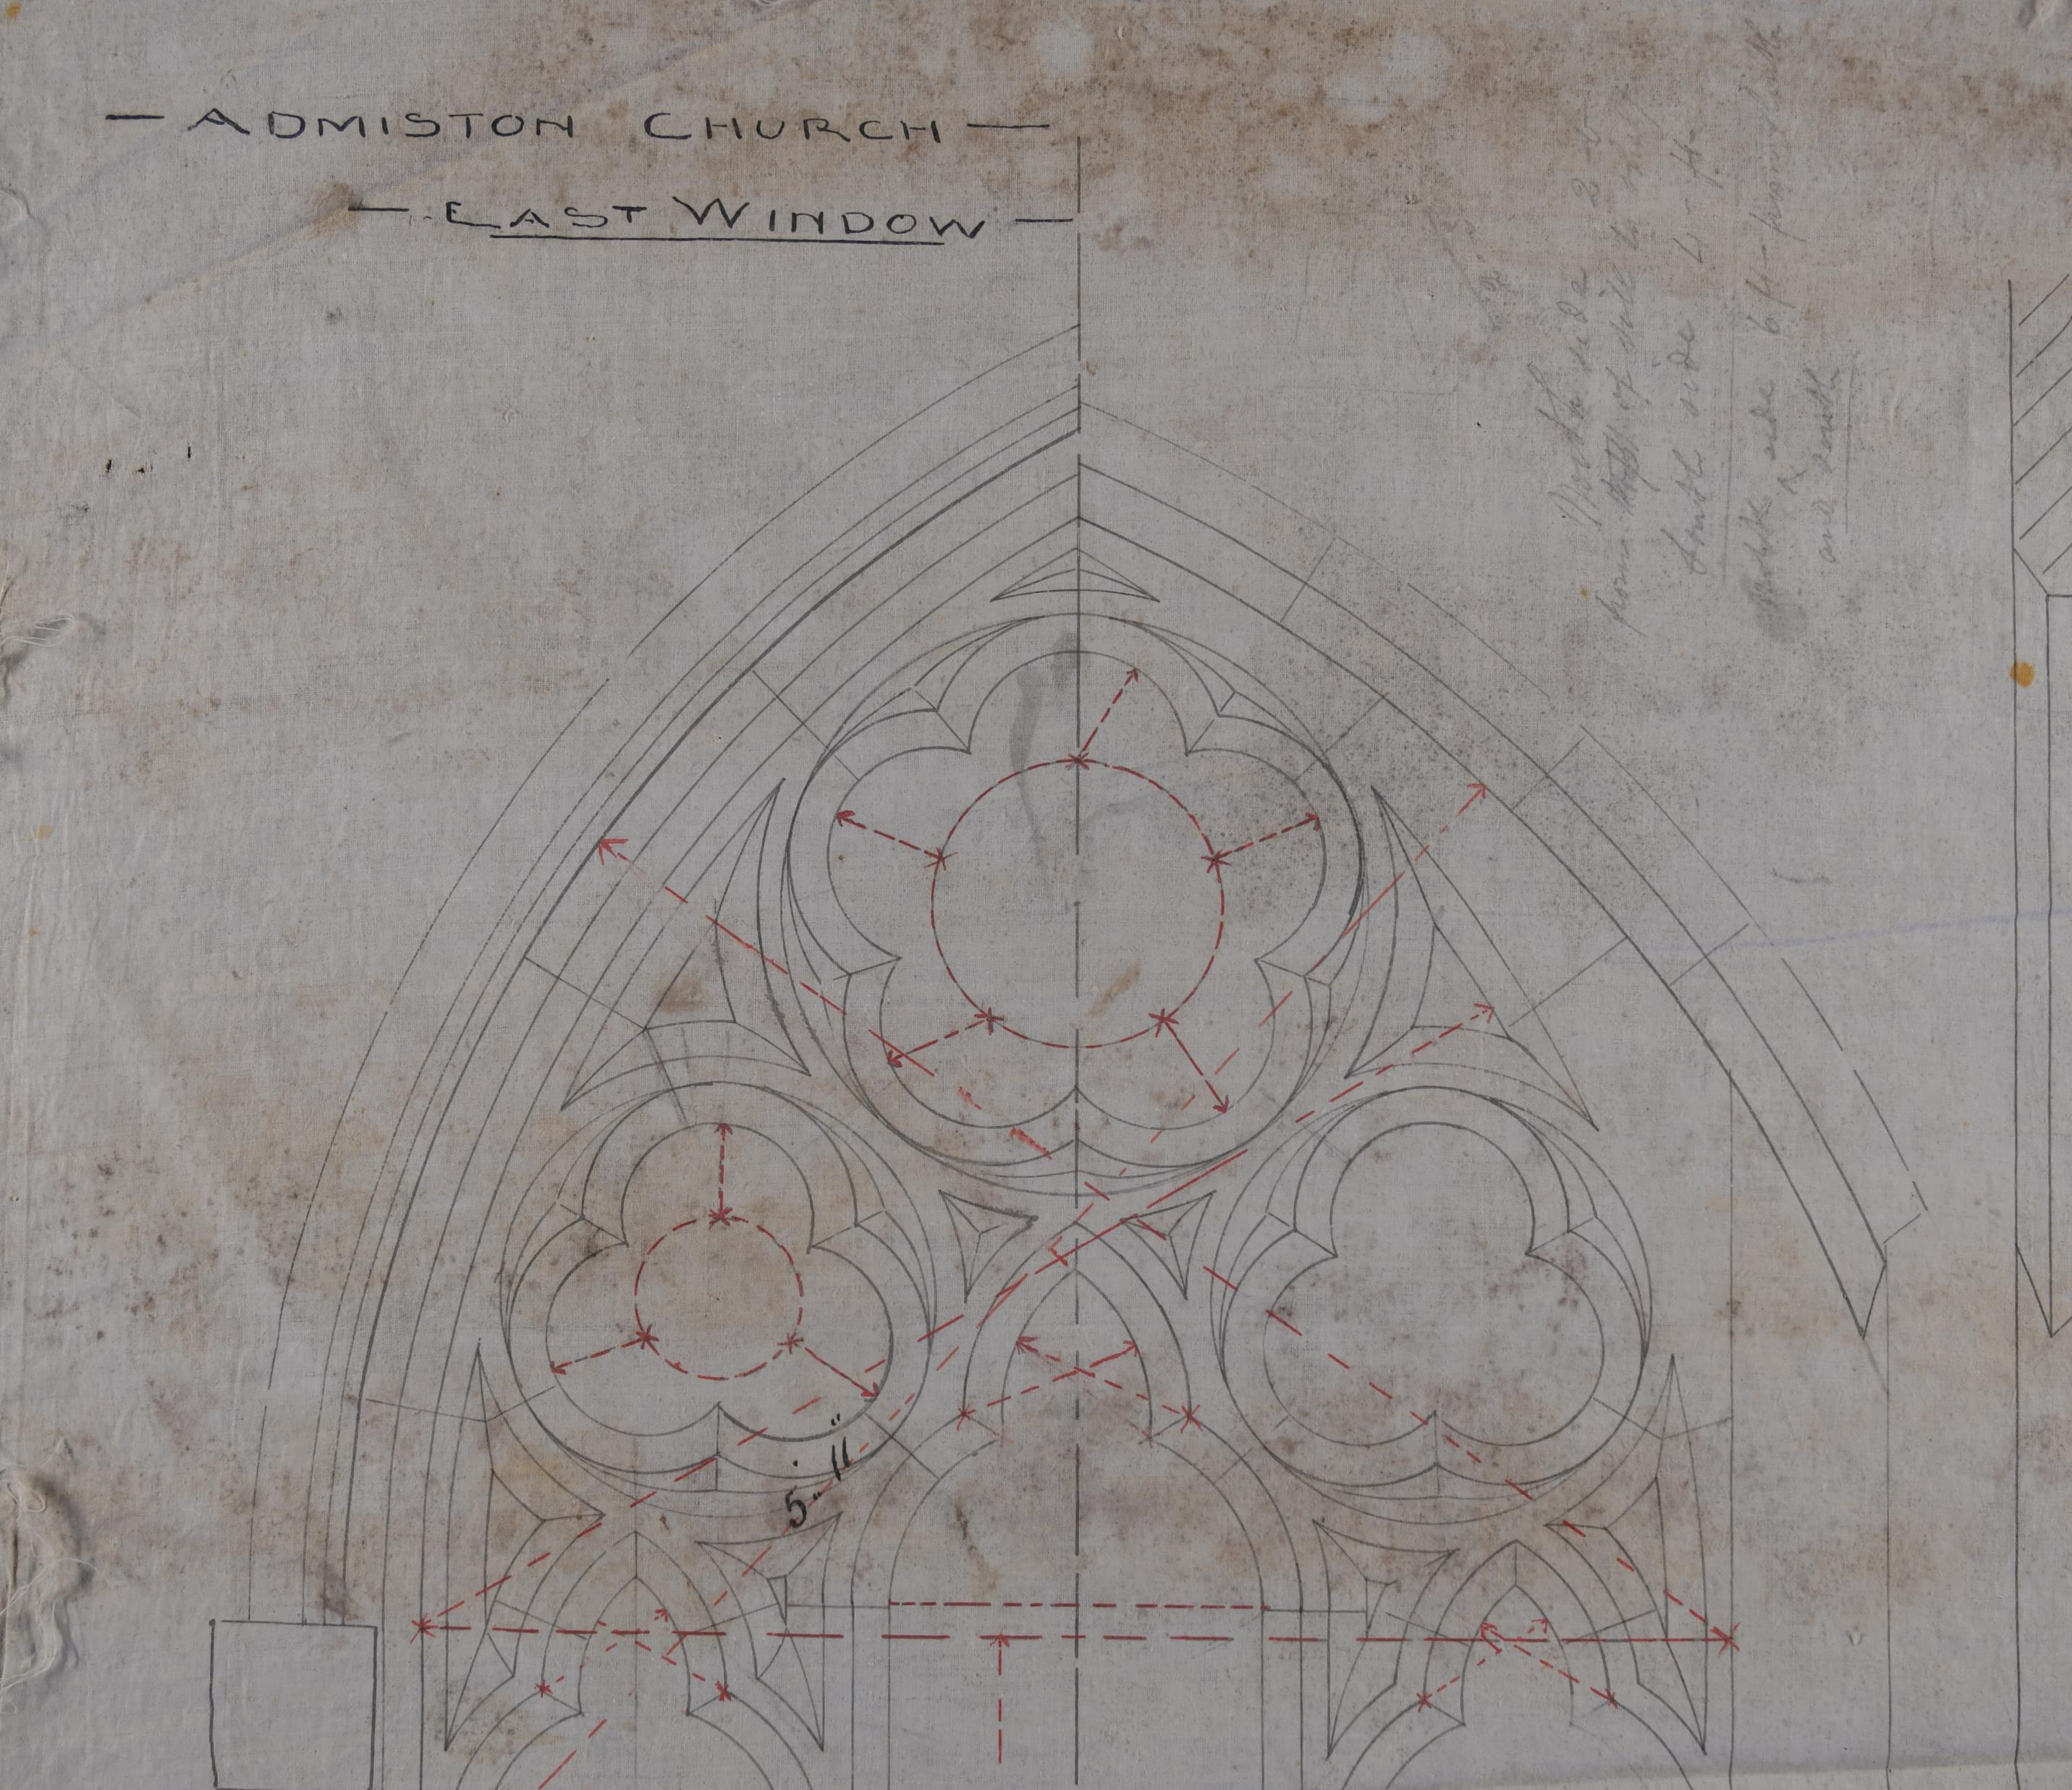
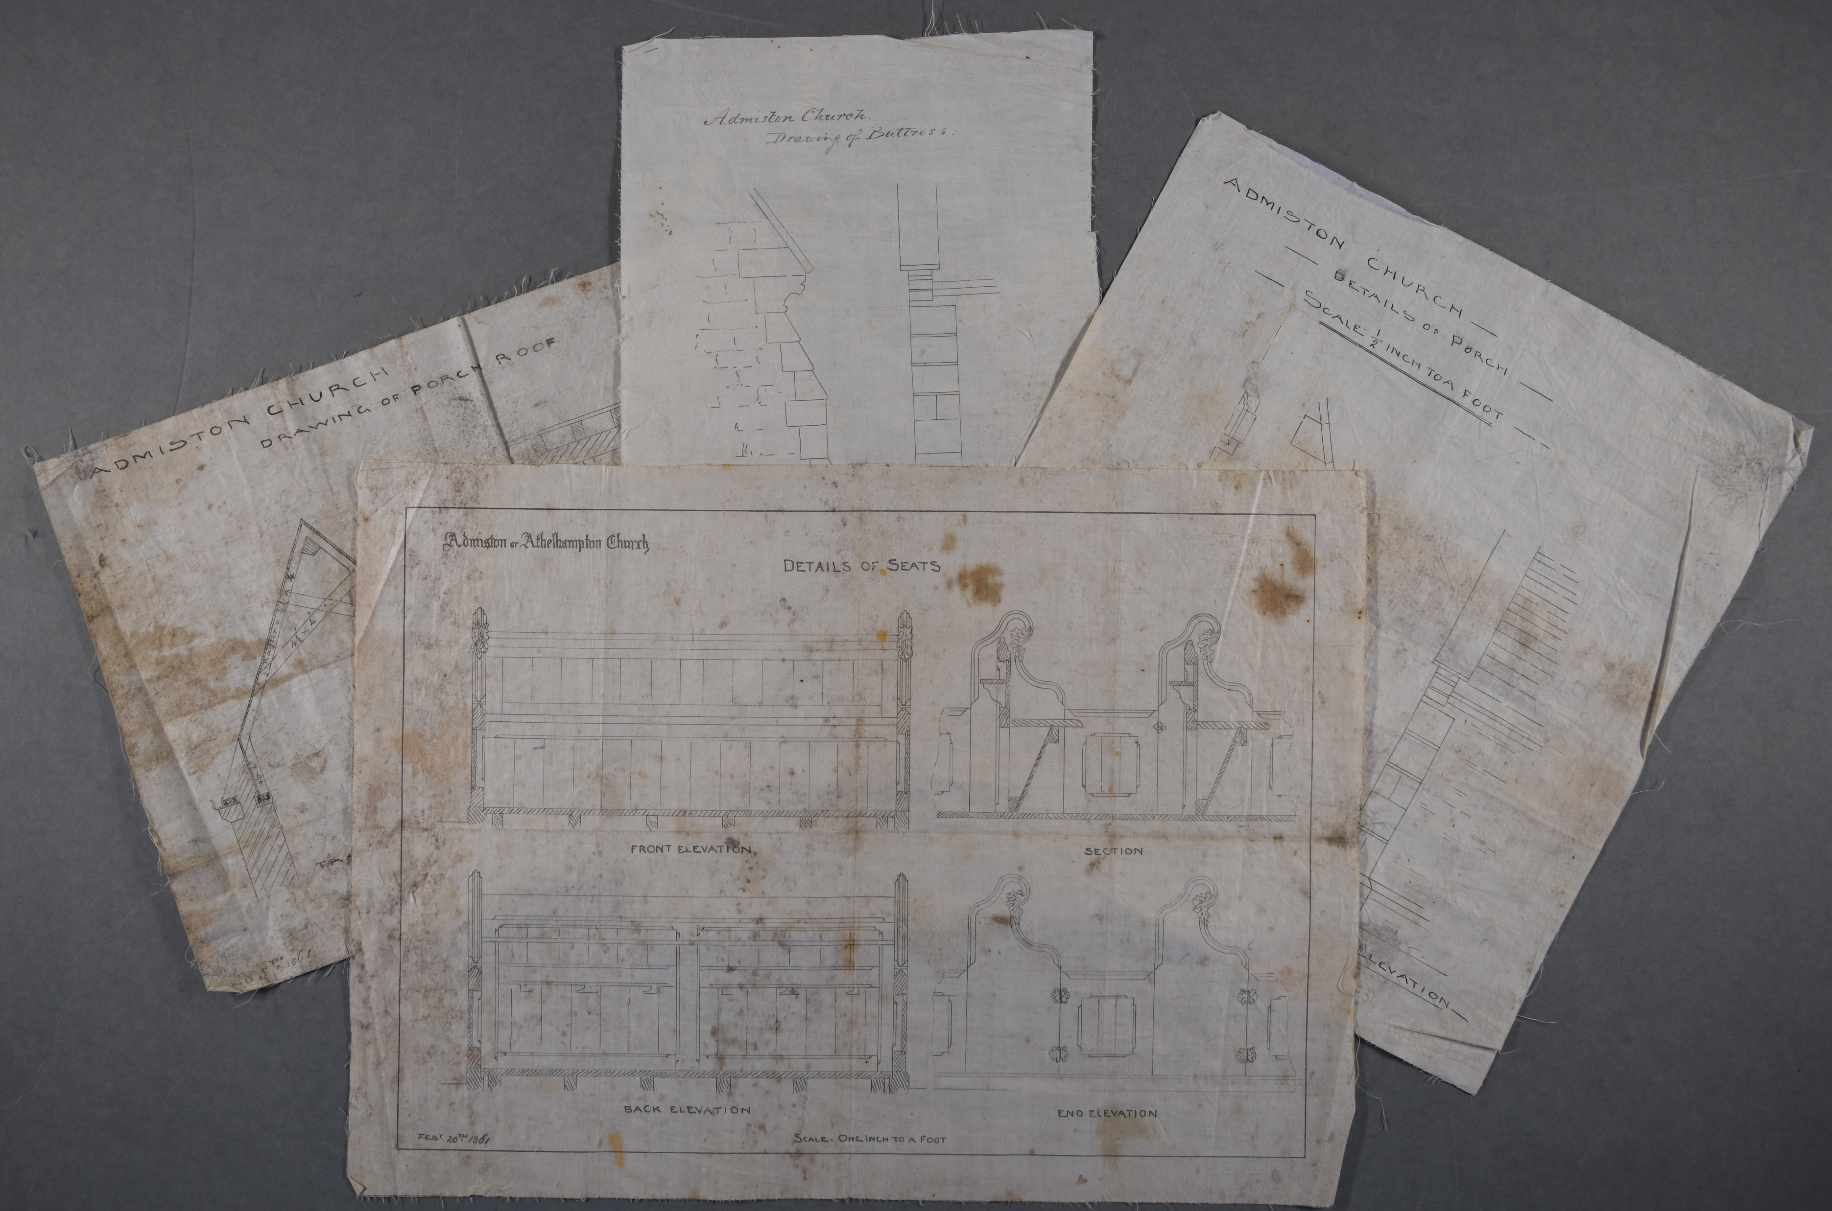
Athelhampton Church, drawn by Hardy, 1861
Accession 11817 –purchased June 2022
Notes:
These are a selection of images from a set of architectural drawings that we recently purchased showing some of Hardy’s work before he

Slide 7
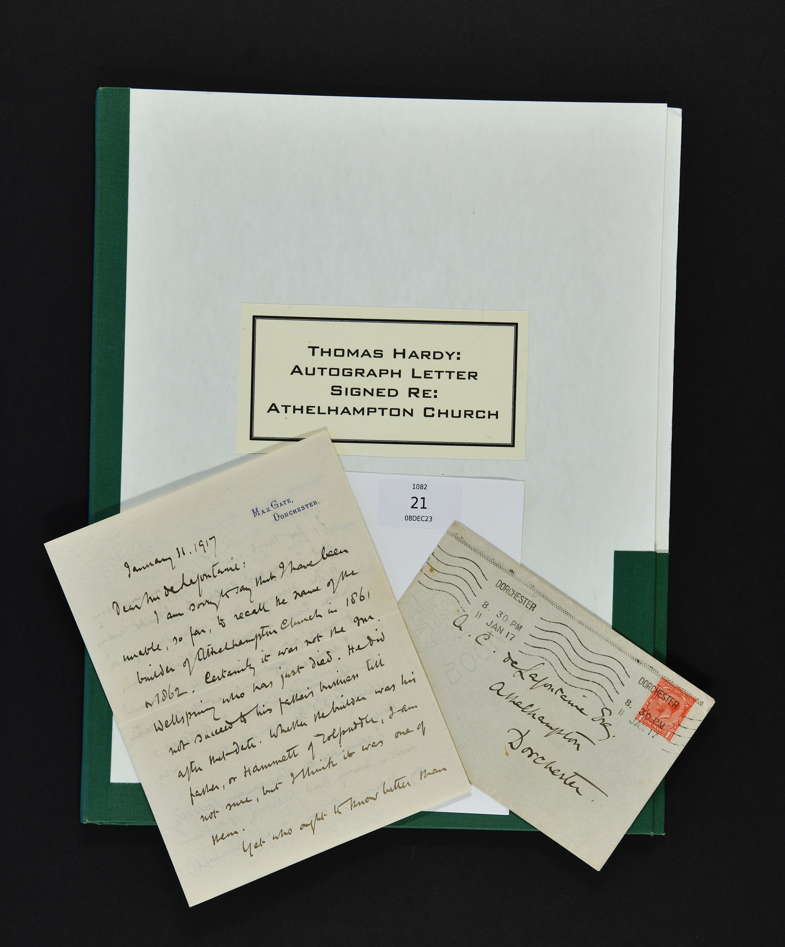
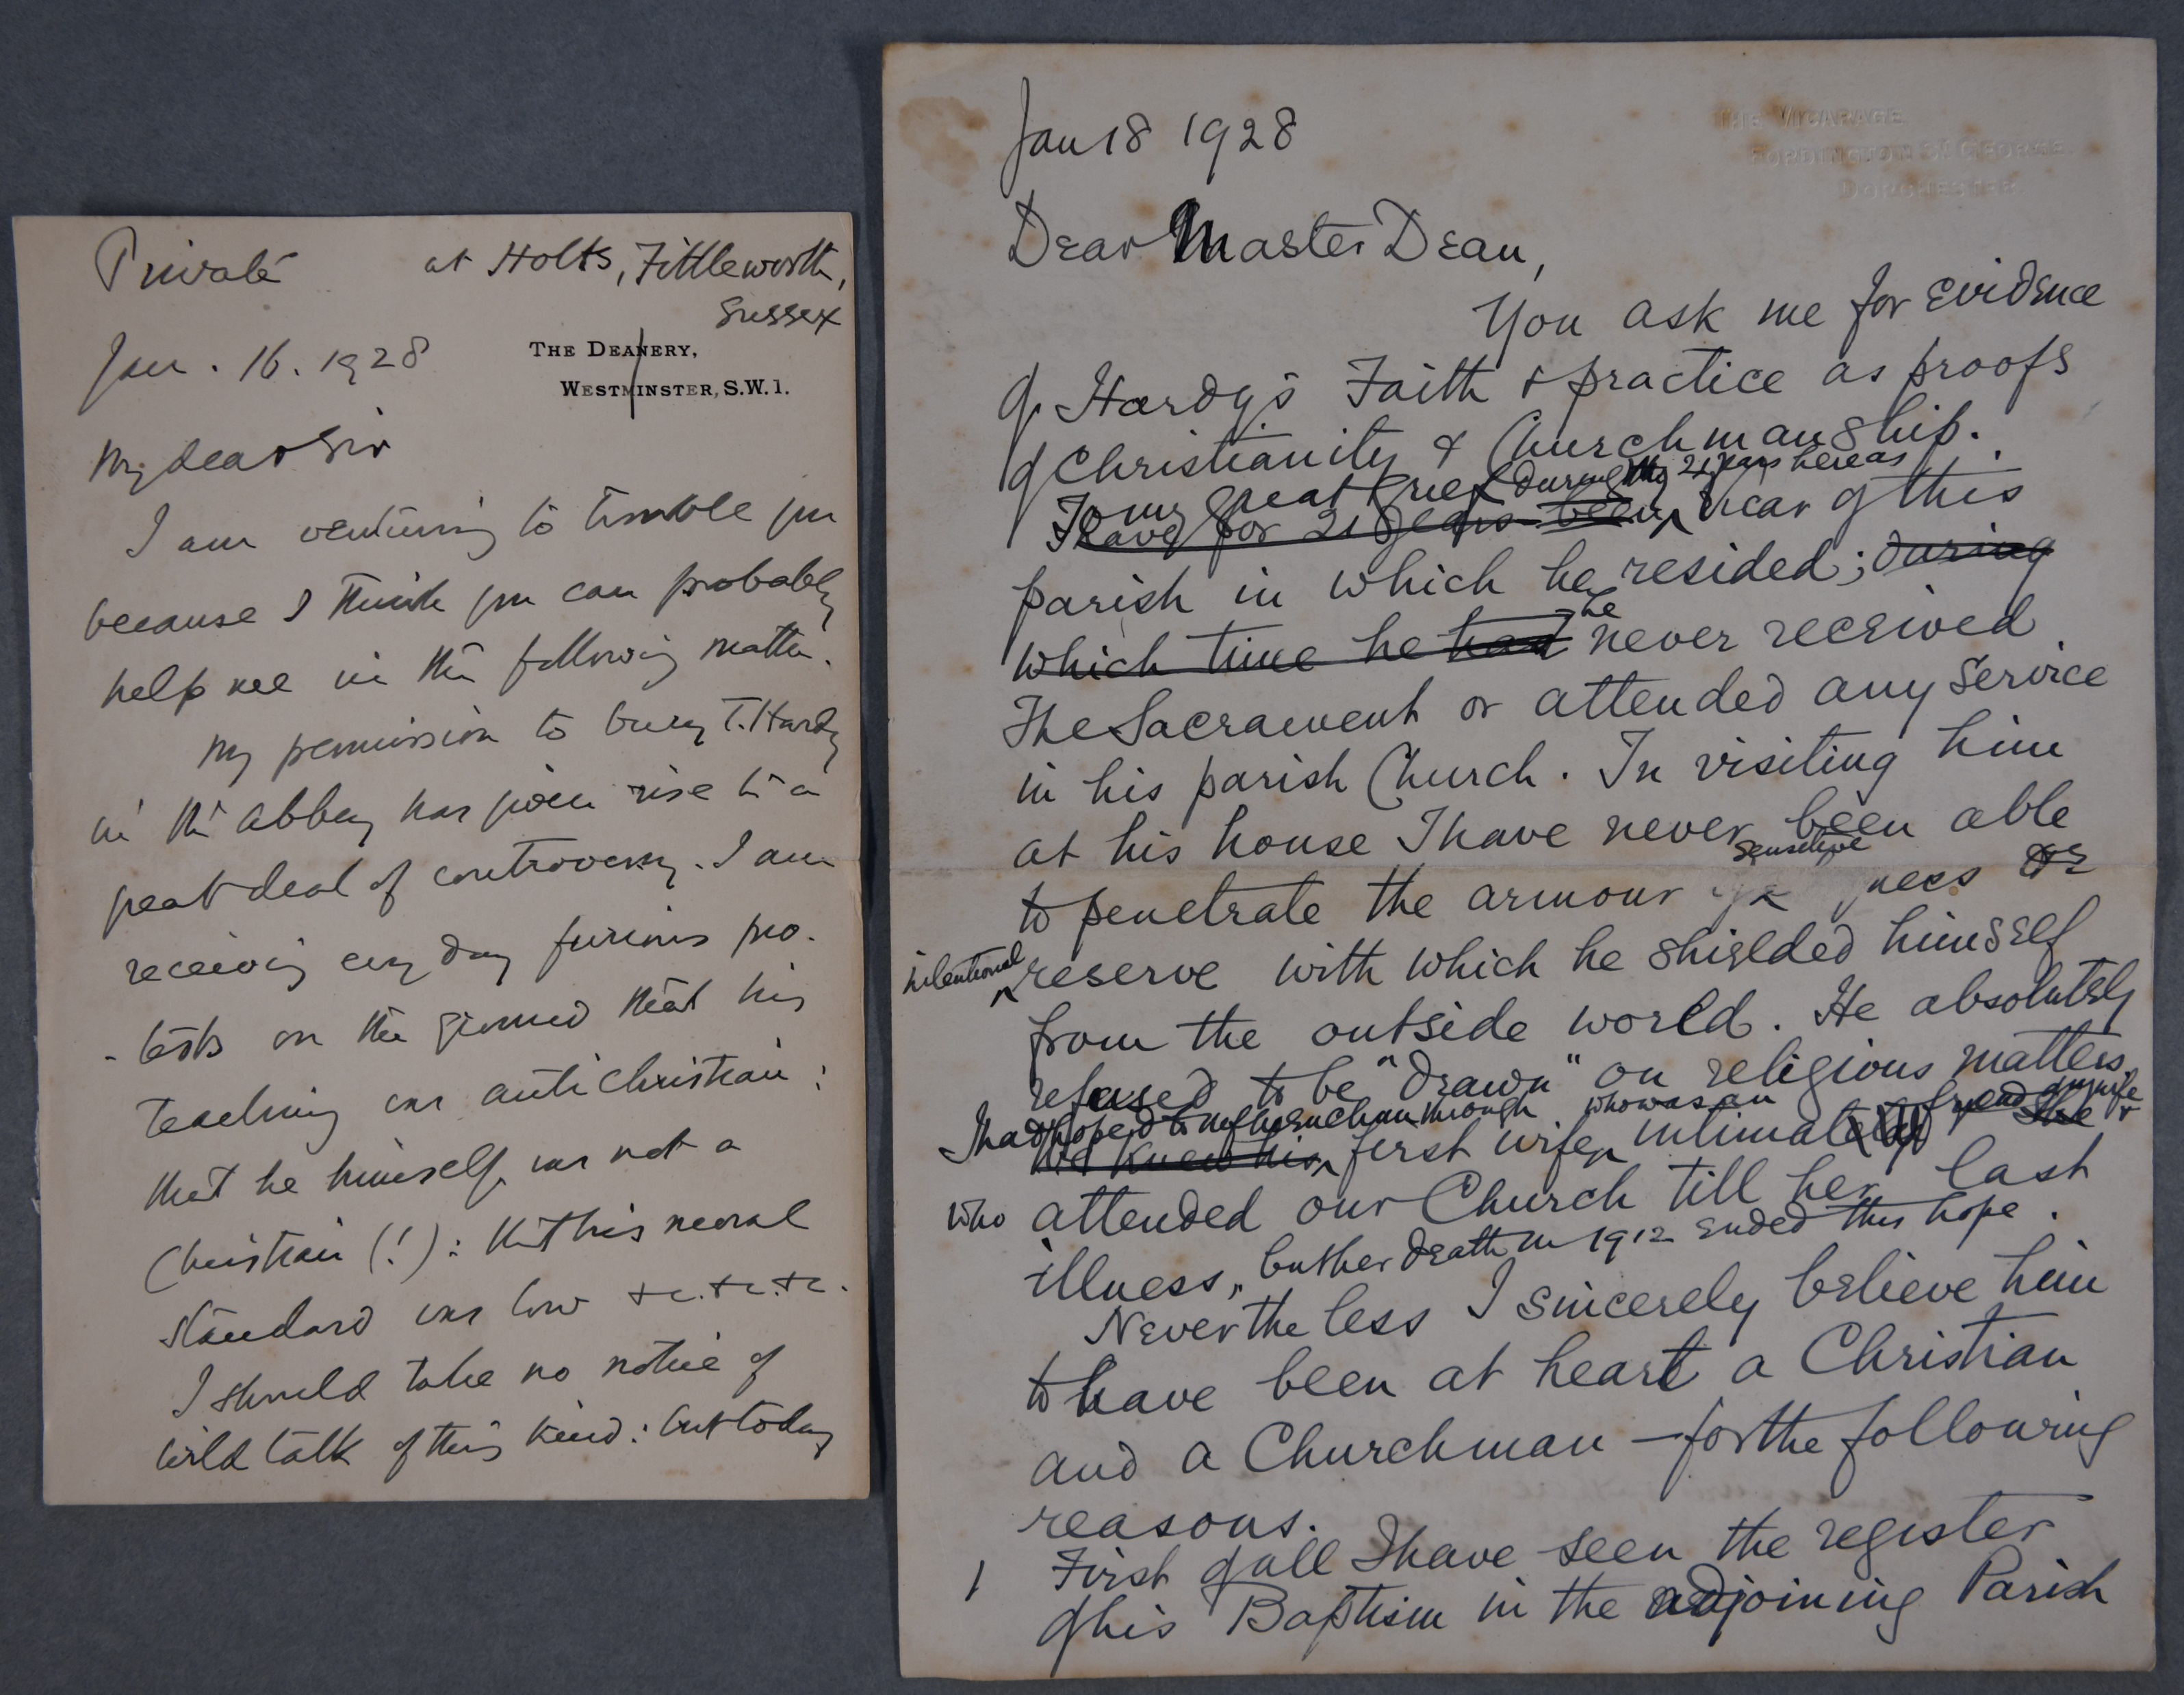
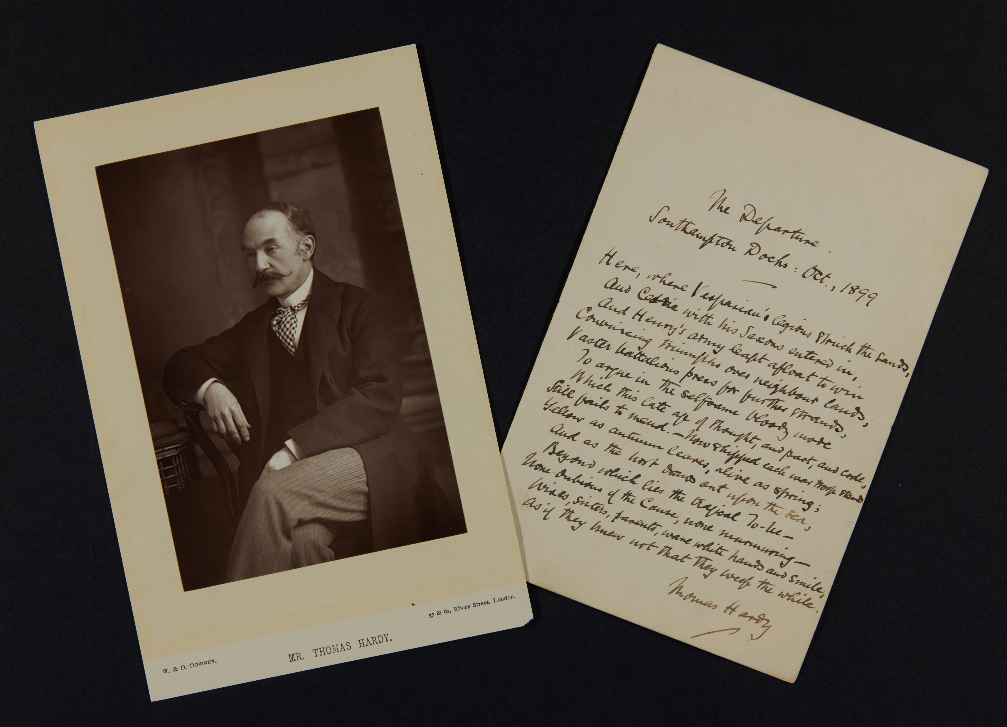
Correspondence and ‘The Departure’

Slide 8
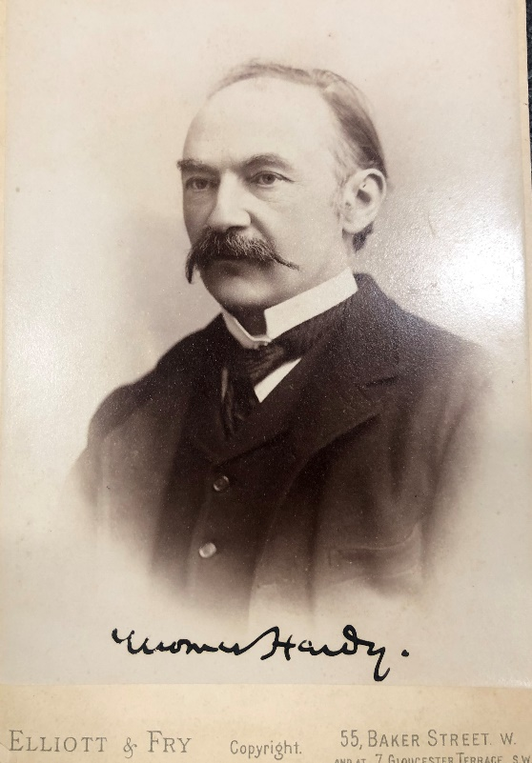
Thomas Hardy Archive Project
18 months, March 2024 – August 2025
Make the archive accessible and discoverable via an online catalogue
Catalogue c. 150 boxes and folders of Hardy related material
Integrate material on deposit from Dorset Museum with material owned by or otherwise held at Dorset History Centre

Slide 9
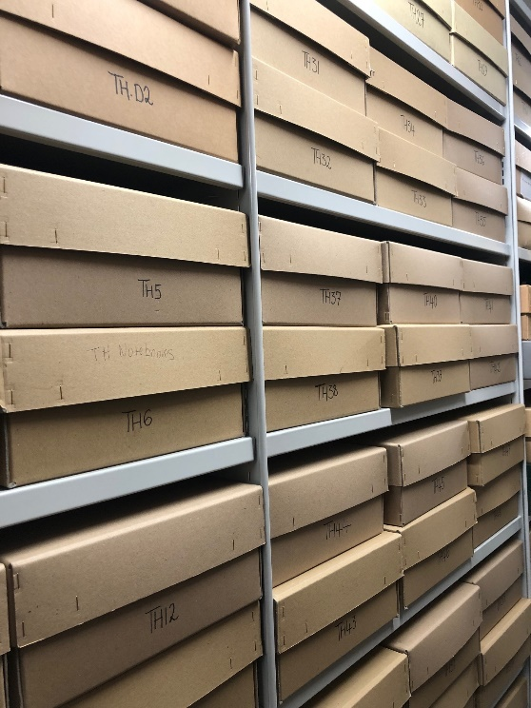
First five months - achievements:
Initial audit of collection
Collection arrangement agreed
Physical rearrangement completed
First steering group meeting: Dorset Museum; National Trust; Thomas Hardy Society; University of Exeter
Internship started
Cataloguing started
Next five months - goals
Complete first tranches of priority cataloguing
Publish first completed series online
Begin volunteering project

Slide 10
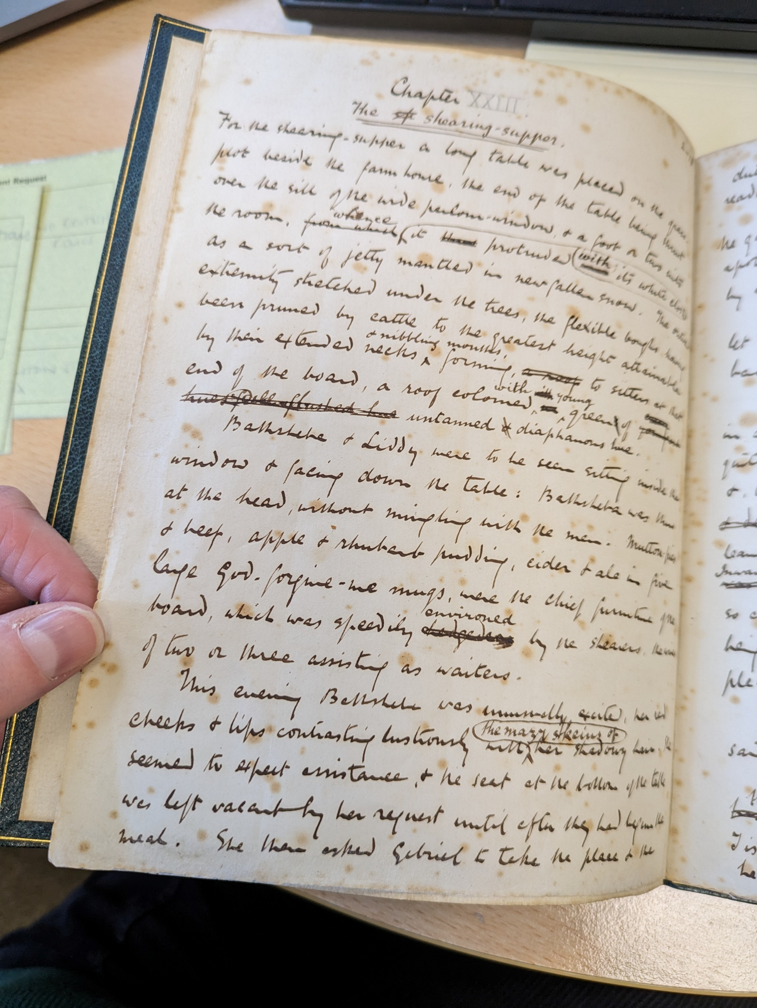
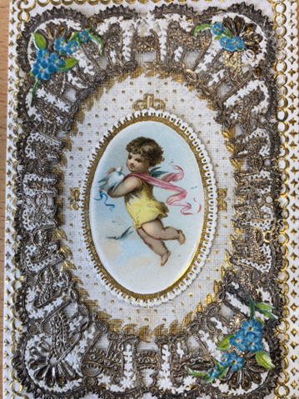
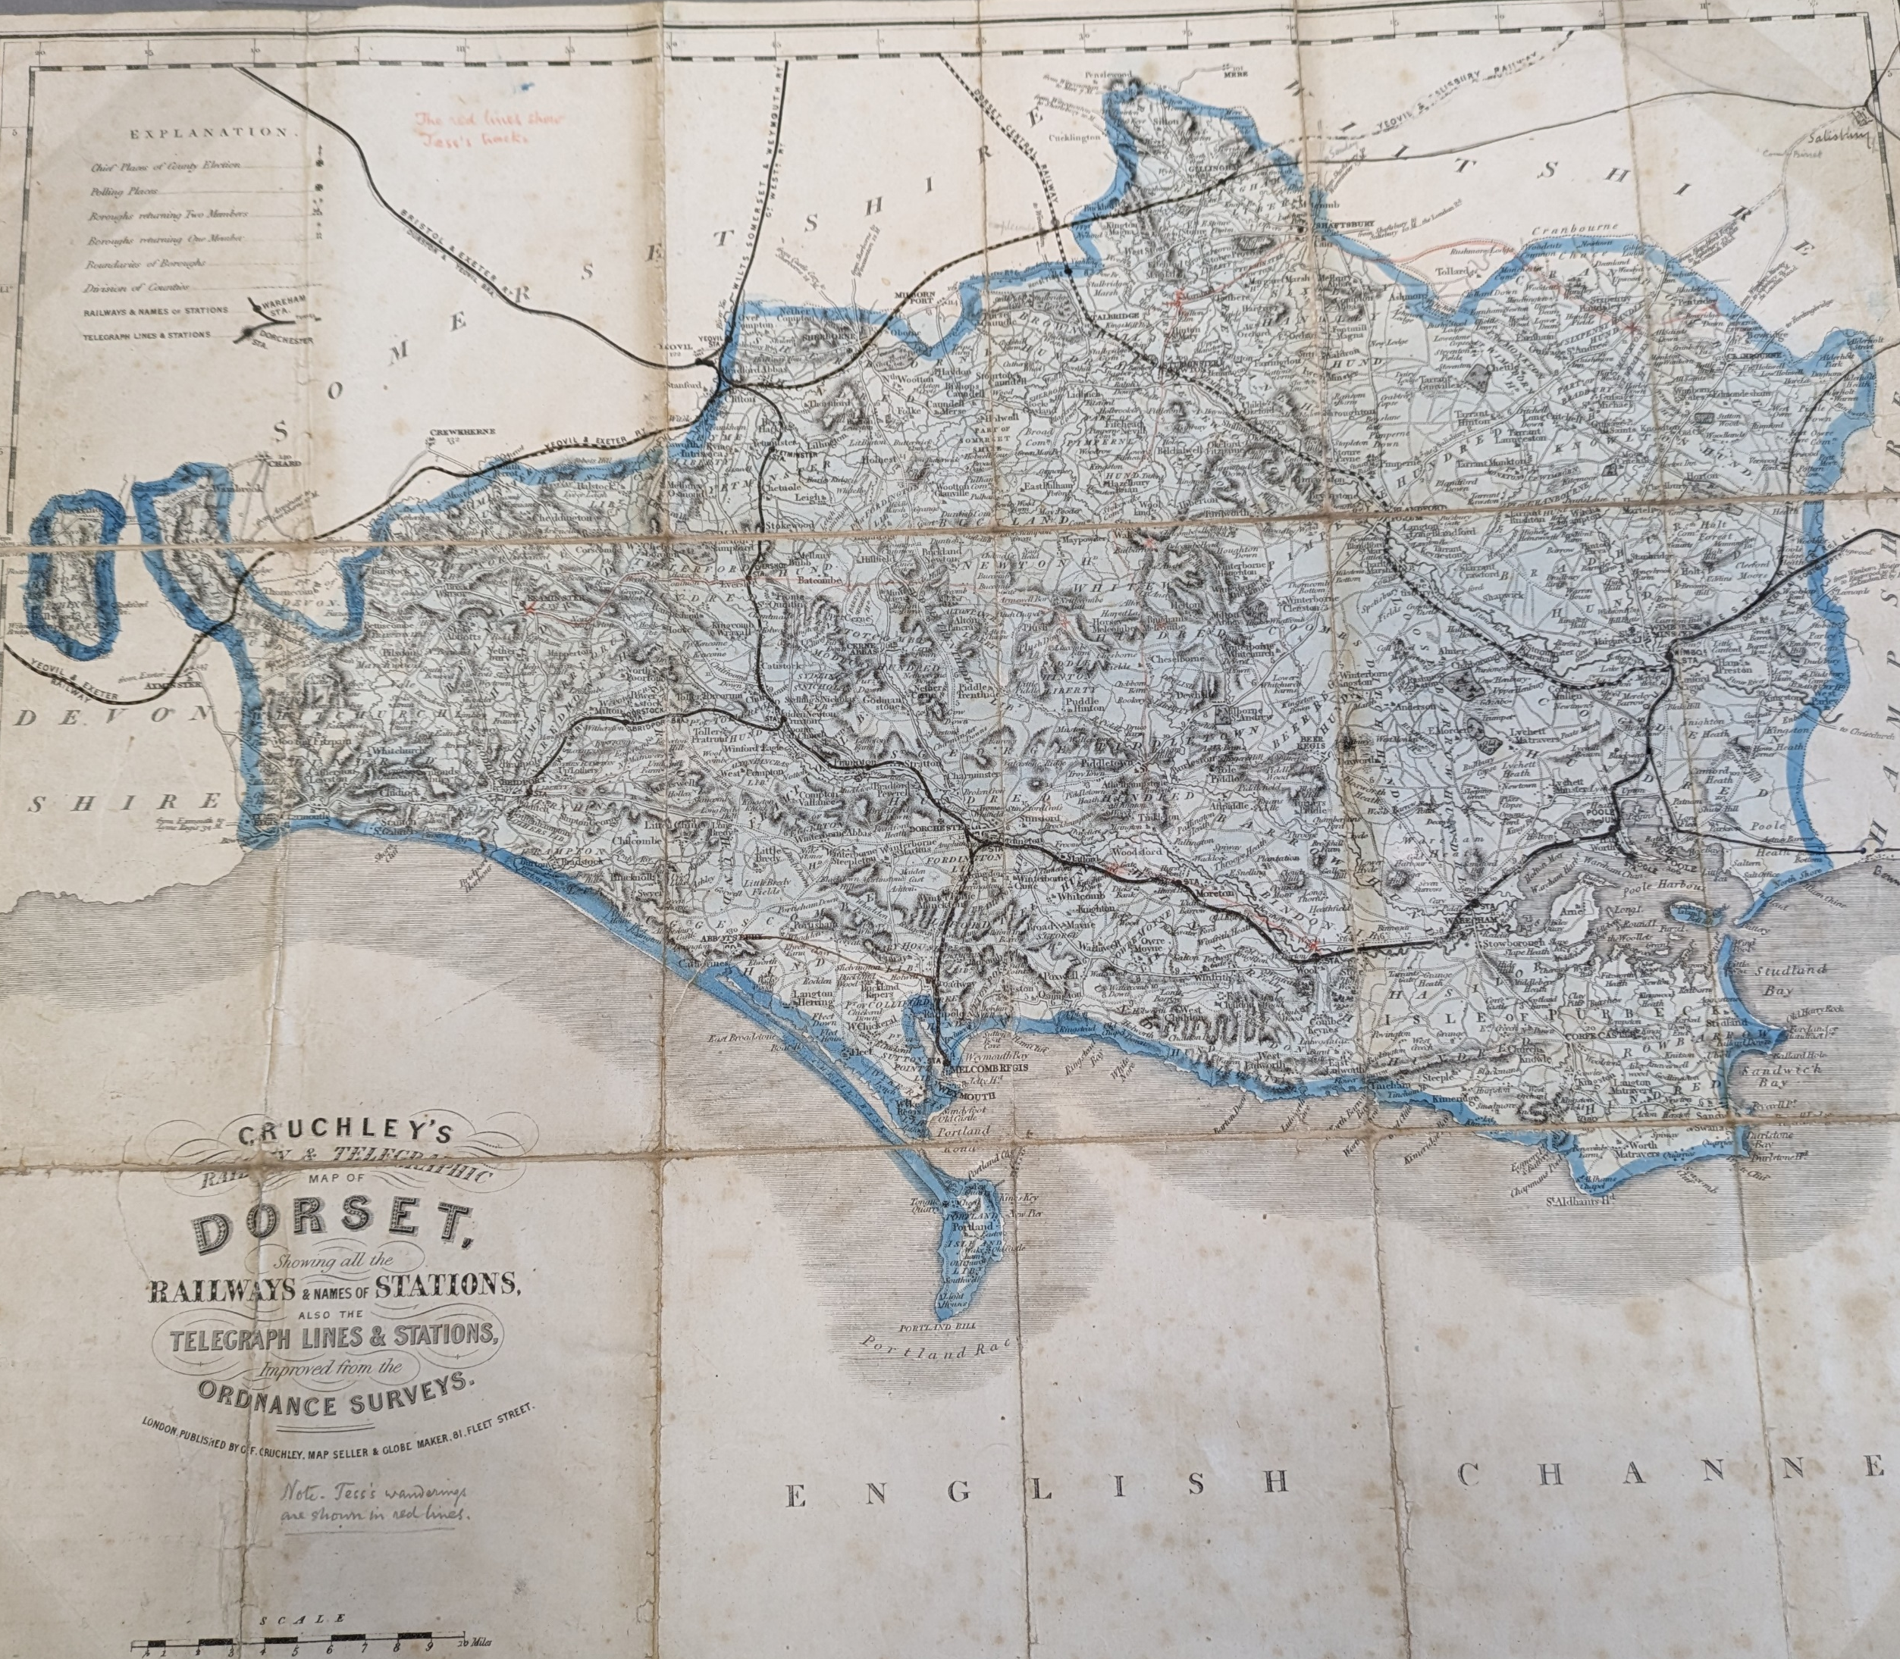
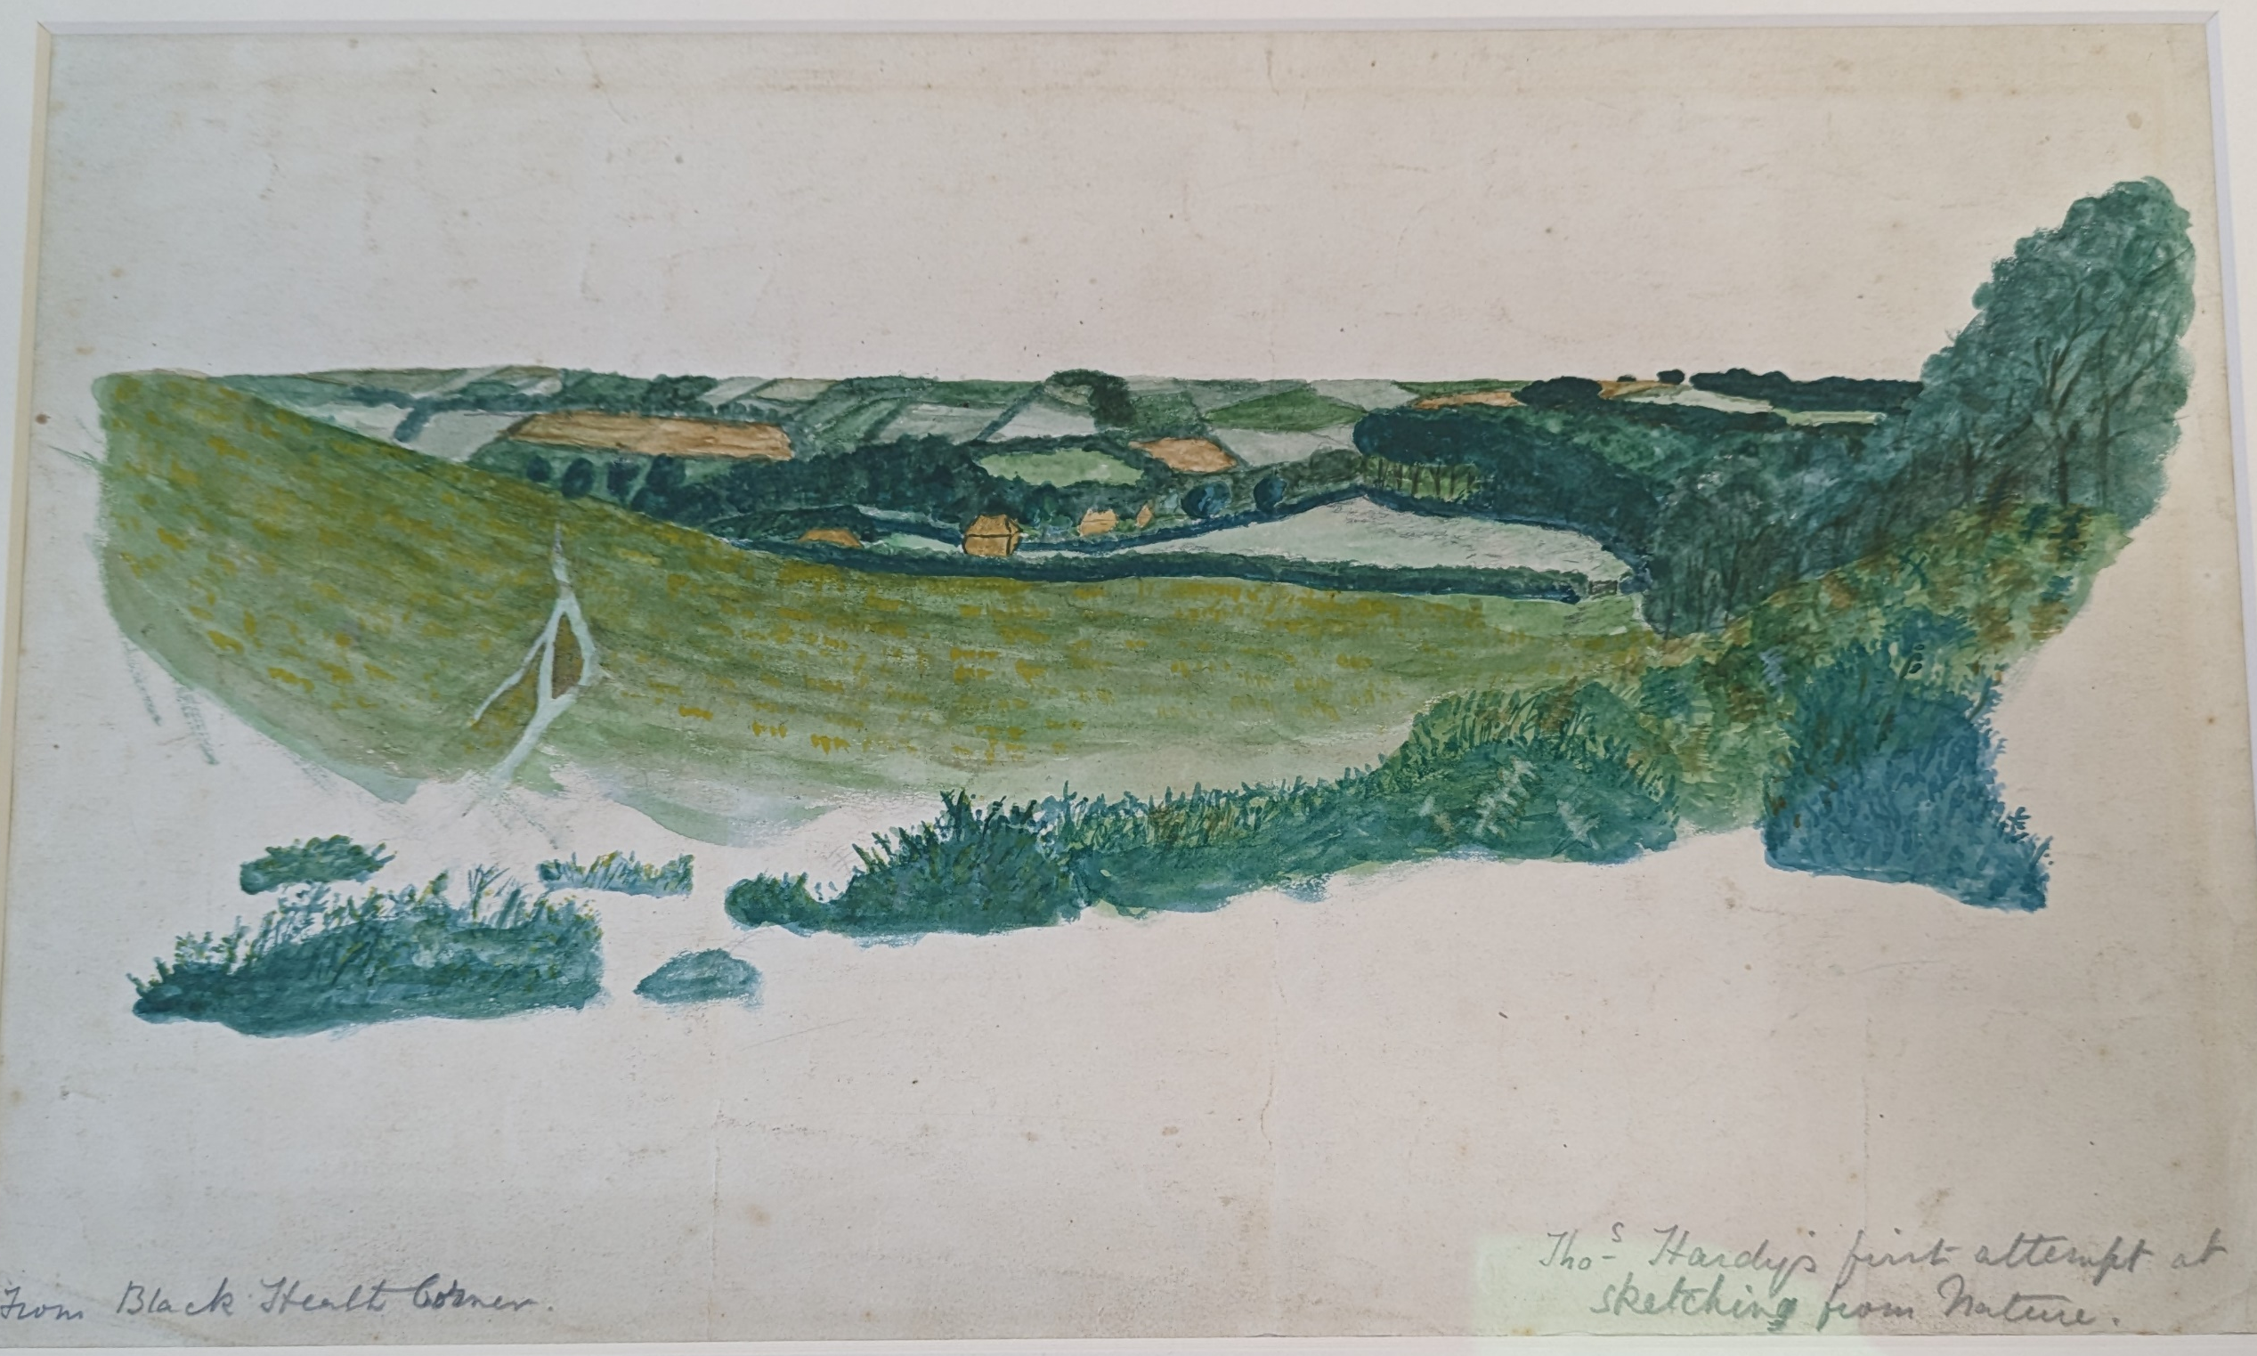
Hardy Collection: Significance and scope
Manuscripts
Correspondence
Art works
Architectural plans
Music
Family papers
Domestic & financial
Personalia
Notes:
Find better images for a range of material in the collection

Slide 11
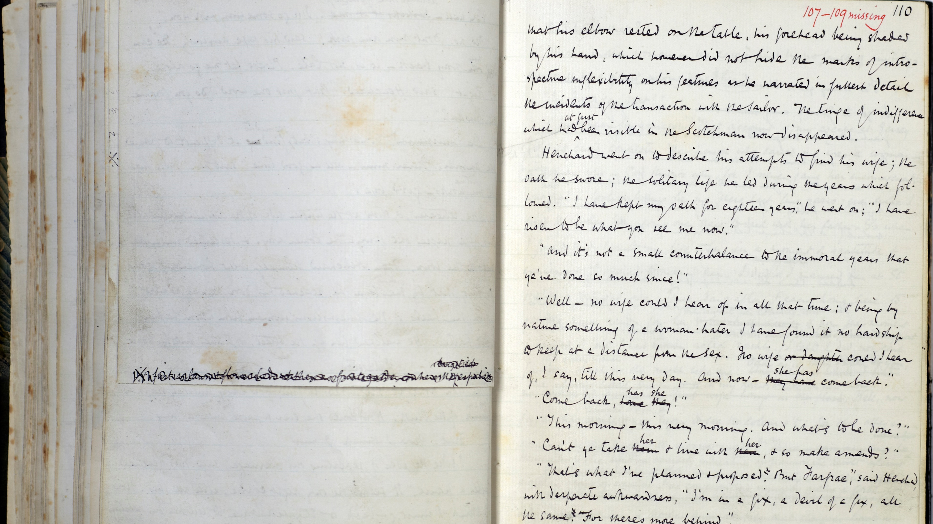
Hardy Collection: Magic and meaning in the archive

Slide 12
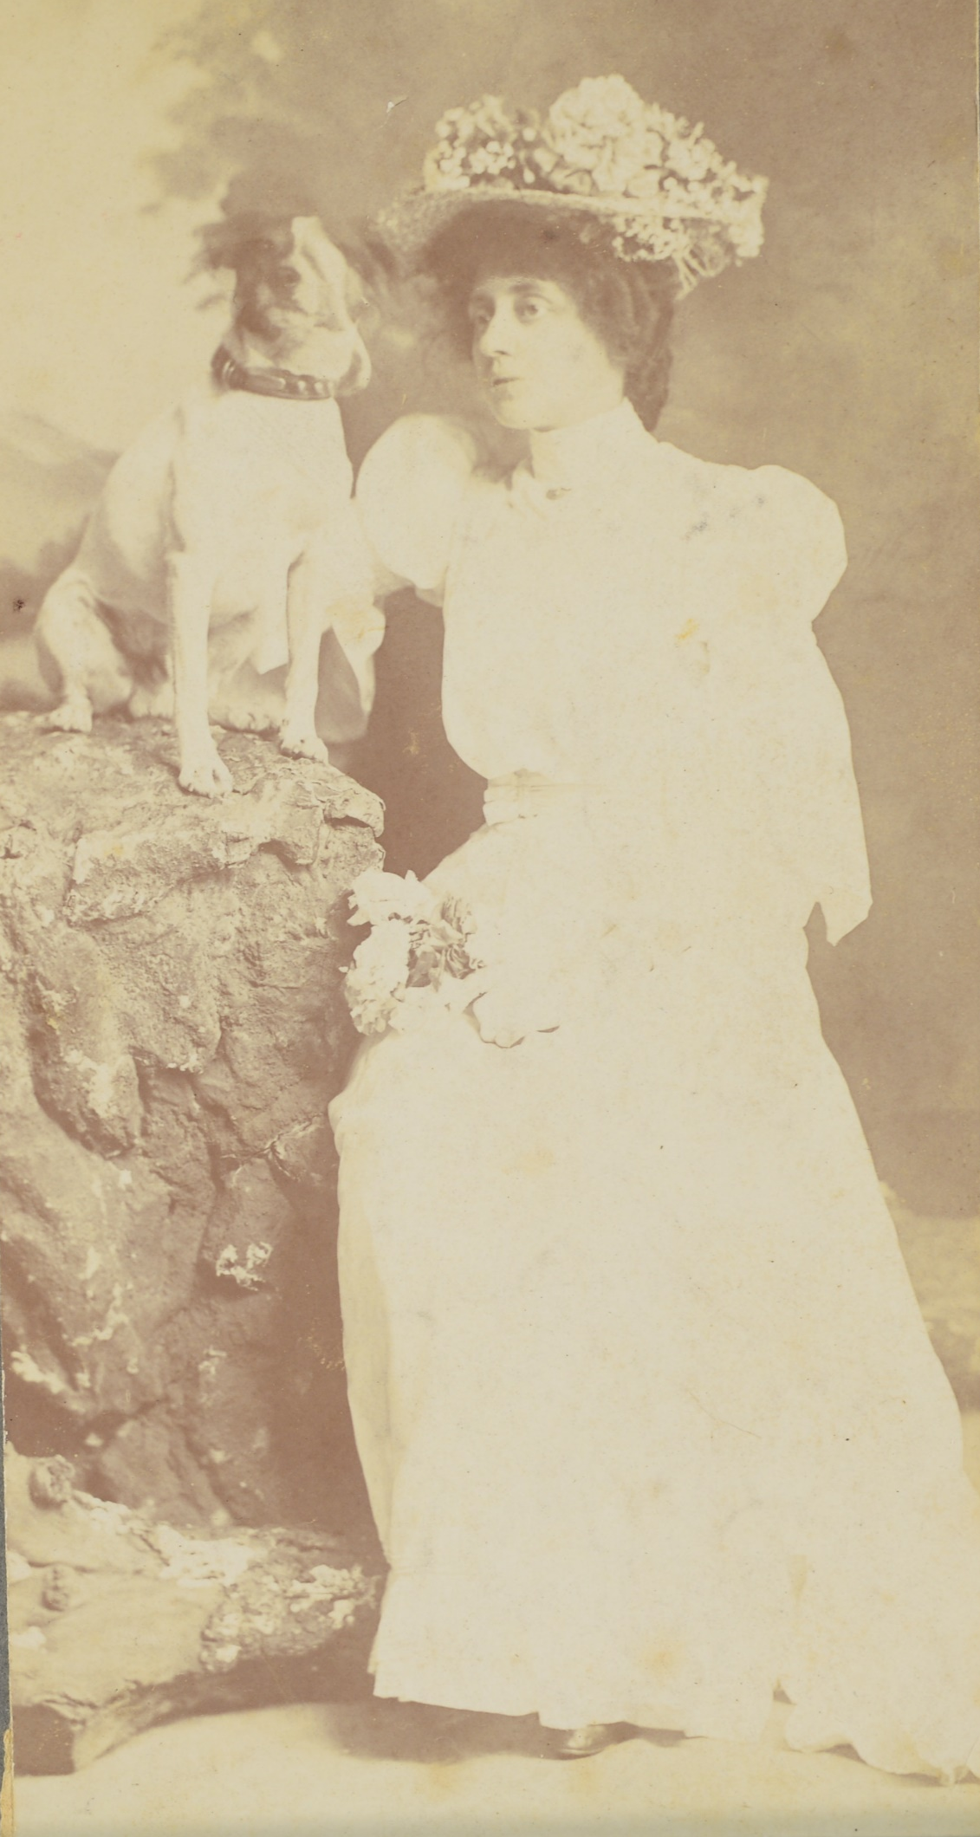
Hardy Collection: Other voices, other stories
Items relating to Hardy’s parents, sisters, brother and wider family
Items relating to Emma and Florence Hardy, including manuscripts, letters, diaries
Ephemera, press cuttings
Legacy of Hardy’s life and works: scrapbooks, secondary research, dramatisations and productions

Slide 13
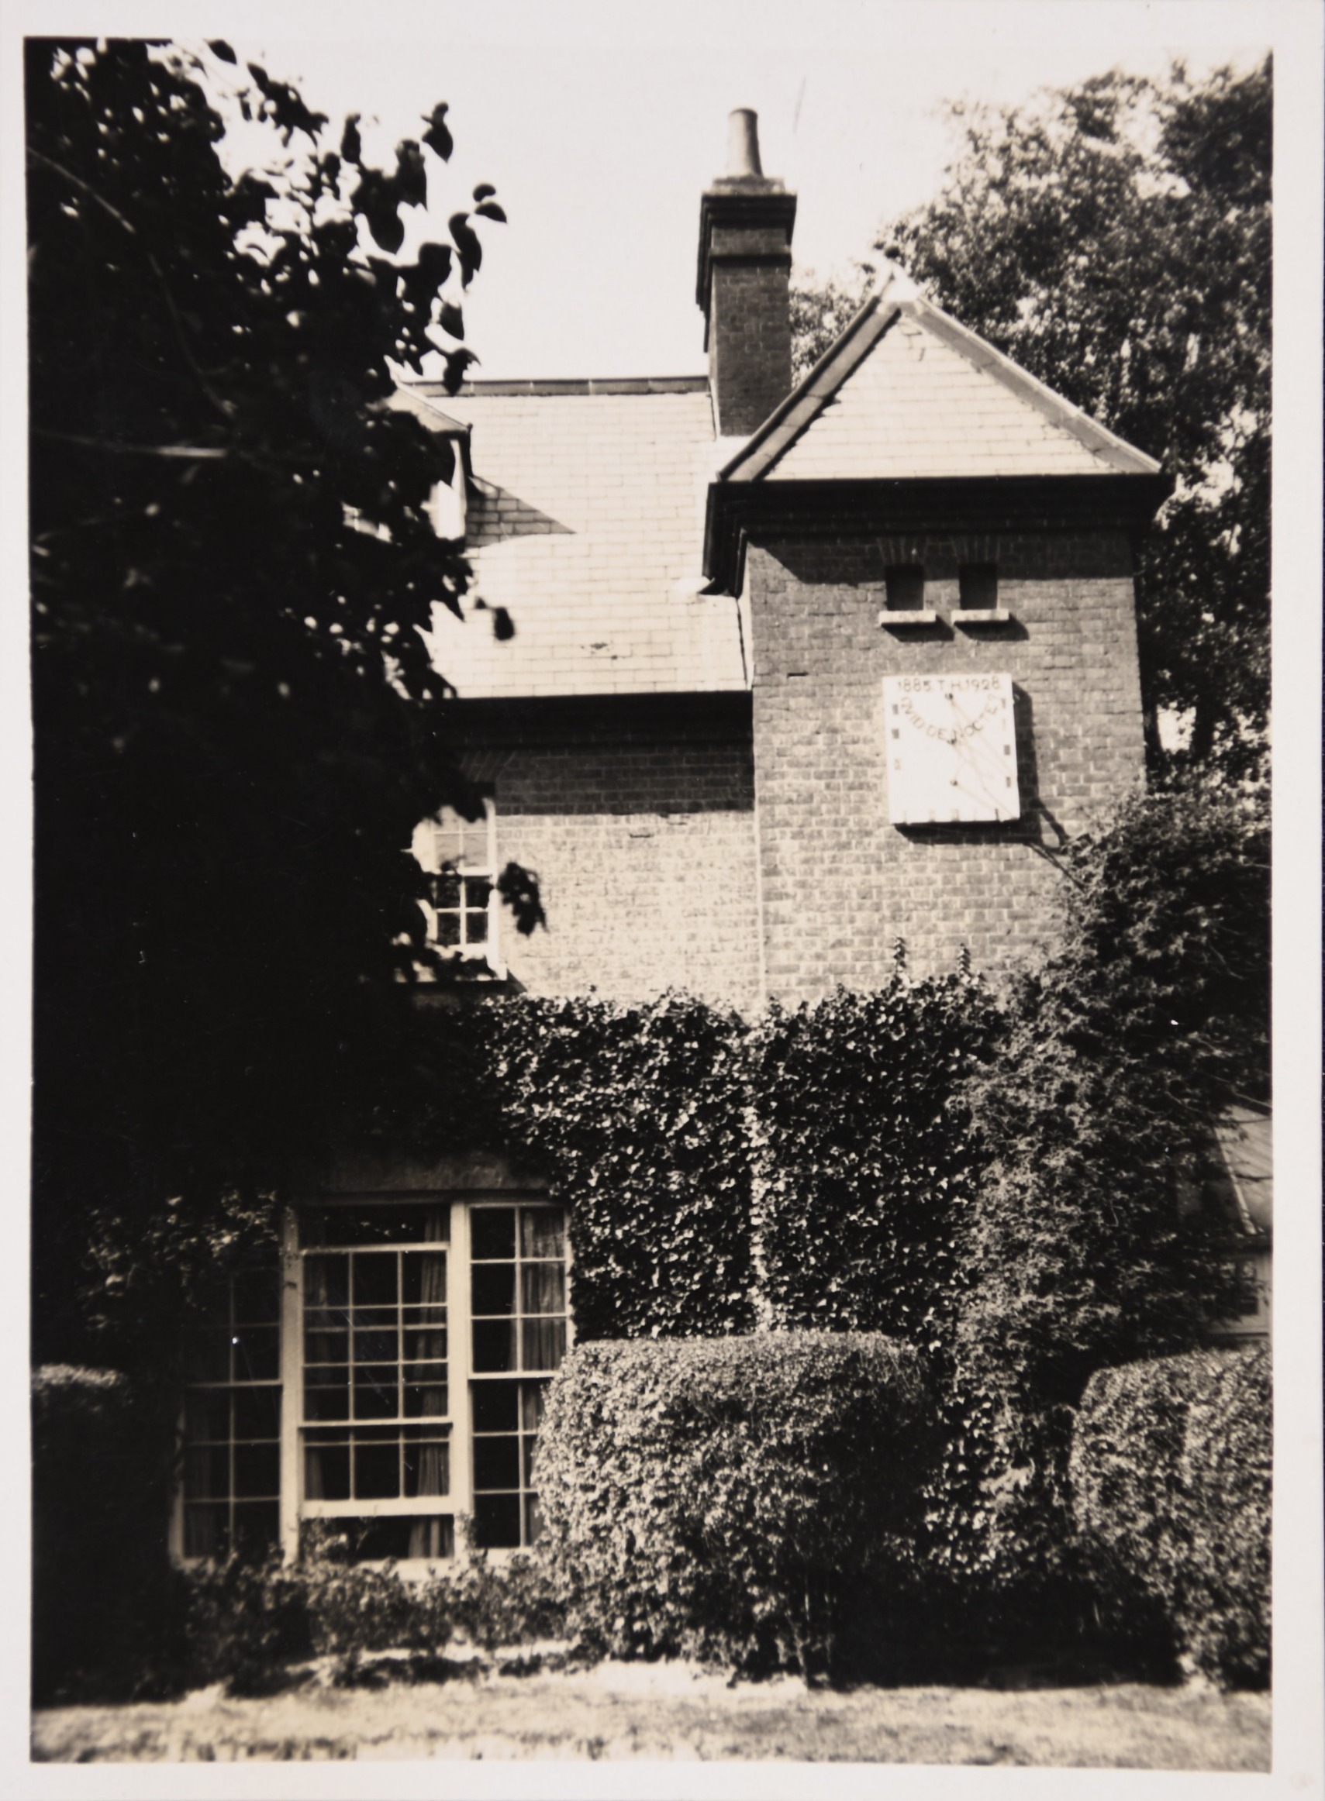
Connections and collaborations
Connections across and between archives
Dorset Museum, National Trust, Thomas Hardy Society, University of Exeter
Other specialist groups
People and organisations of Dorset
International admirers of Hardy, Hardy’s work and Hardy’s world
Volunteer projects, community engagement projects
Notes:
Need picture of Hardy family tree

Slide 14
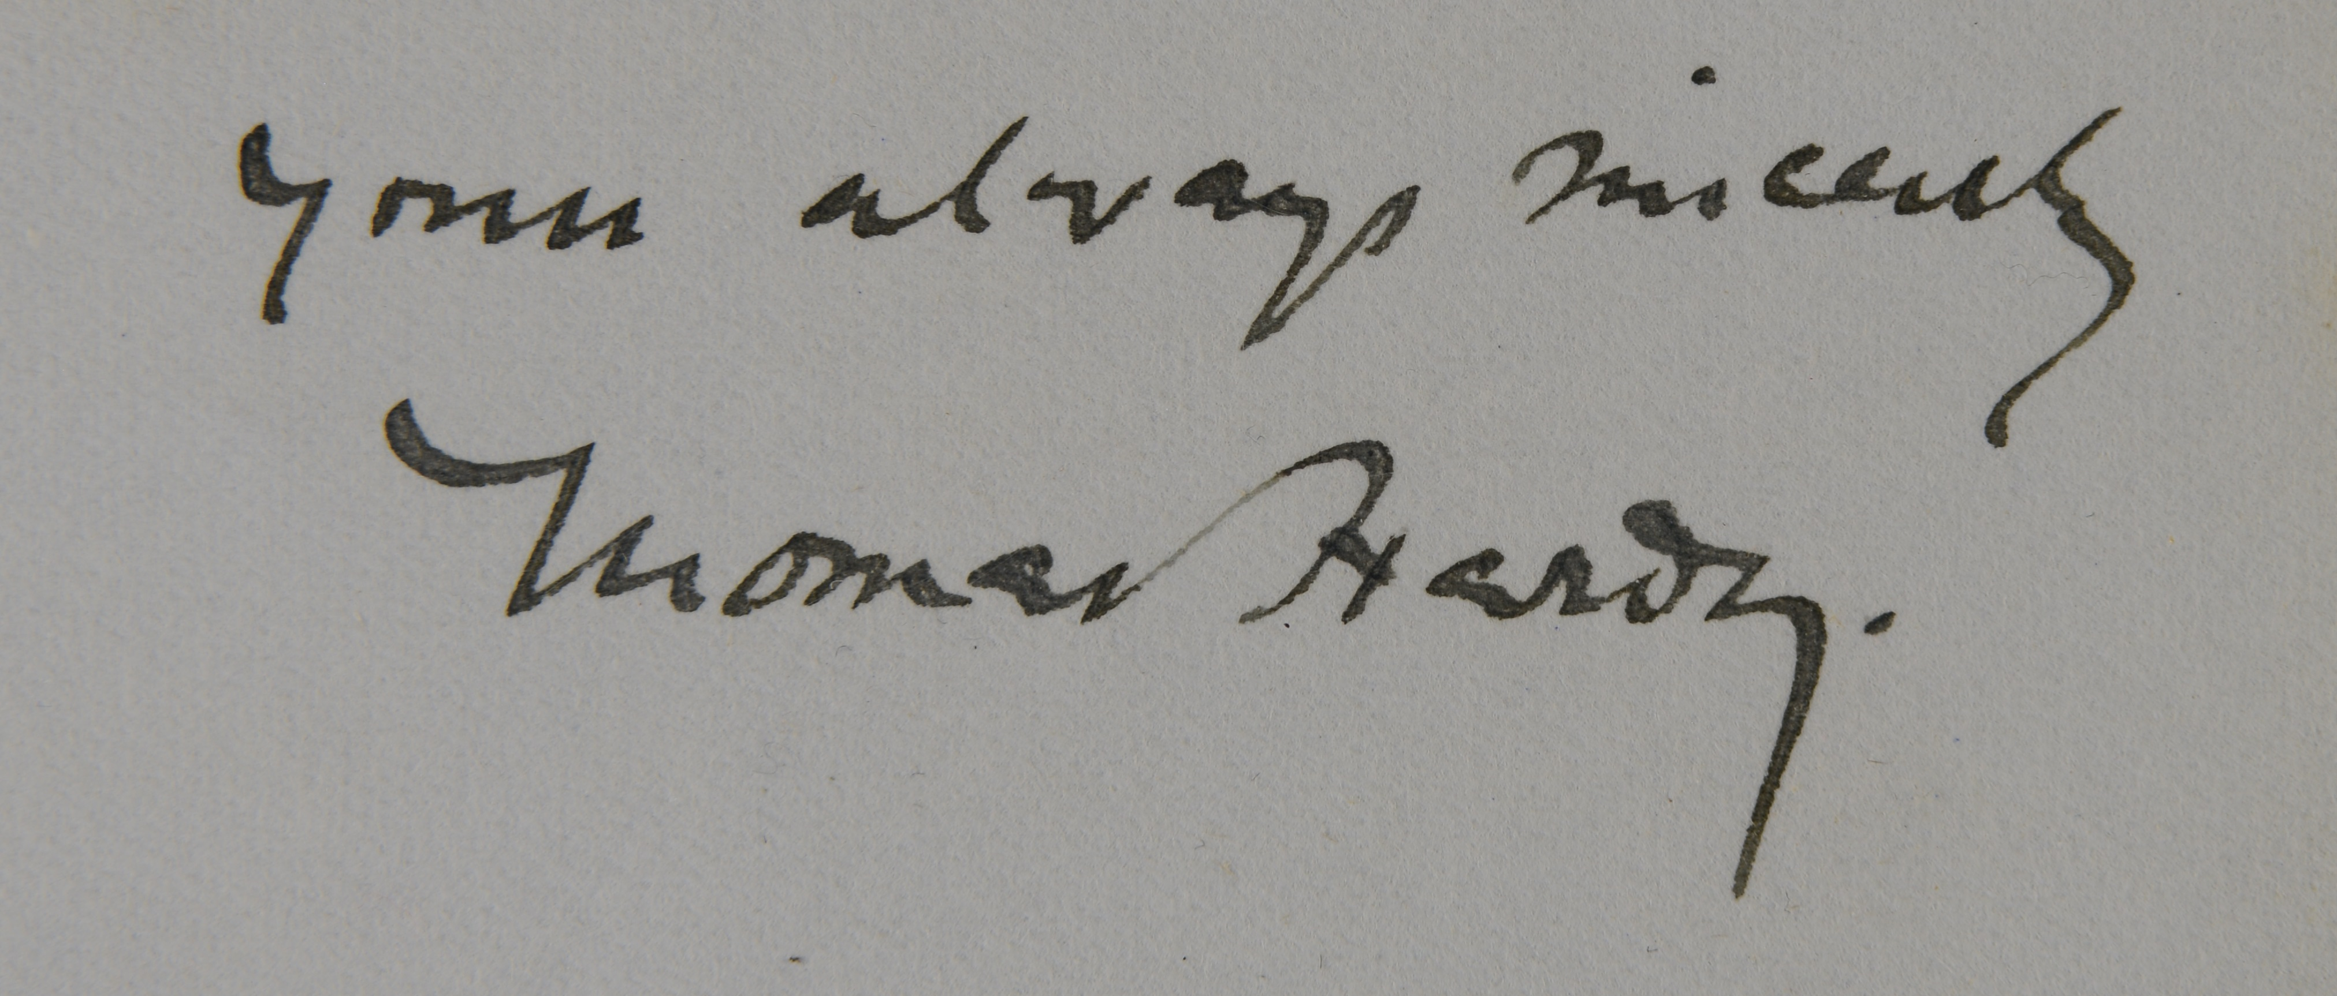
Sam Johnston Sam.Johnston@dorsetcouncil.gov.uk
Ruth Burton Ruth.Burton@dorsetcouncil.gov.uk

